Slide 1


Slide 2





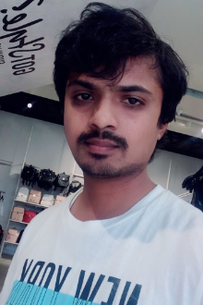

Team Members:
Havya
Jyoshna Lakshmi Akash
Prakash Ramesh Venkata Sai

Slide 3
Agenda
Introduction
Tool and Technologies
Admin - Register/Login Page
Add / Delete Product
Admin History
User - Register/Login Page
Home Page
Chat
My Cart
Product Page
Checkout Page
Order History
Summary
Prakash Mamidi

Slide 4
Introduction:
Emart is an ecommerce website for electronics which is being developed.
Current Project Details
Project name: EMart
Category: E-commerce
Prakash Mamidi

Slide 5
Tool and Technologies:
HTML5
CSS4
JavaScript
PHP
MYSQL
AJAX
PHP MAILER
Prakash Mamidi

Slide 6
Admin - Register/Login Page
Same Register/Login page for User and Admin
0 - User
1 - Admin
Prakash Mamidi

Slide 7
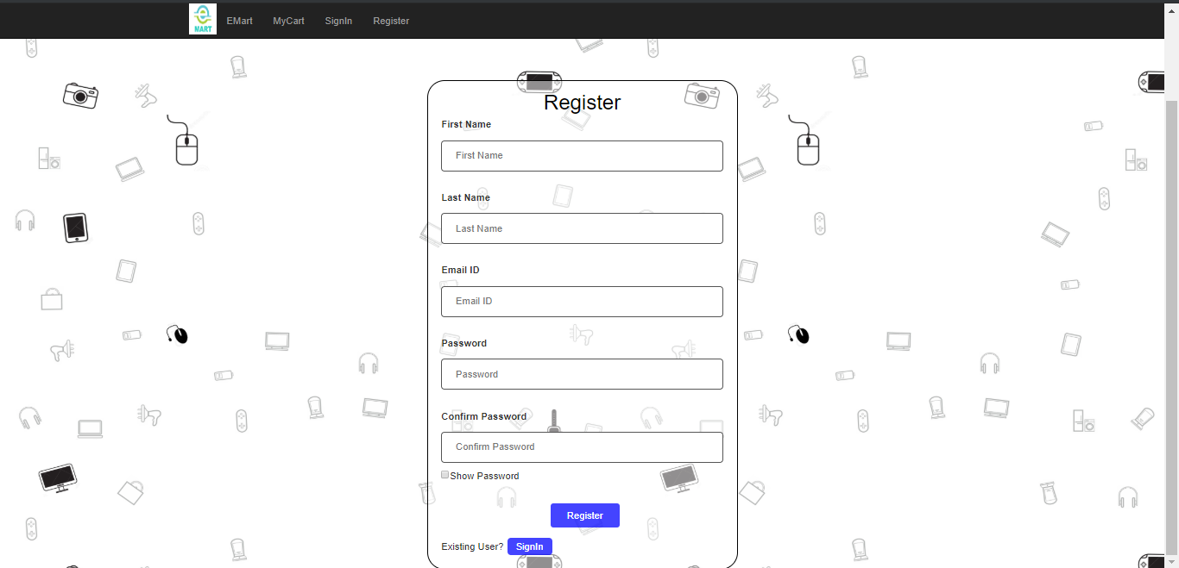
Admin - Register Page
Prakash Mamidi

Slide 8
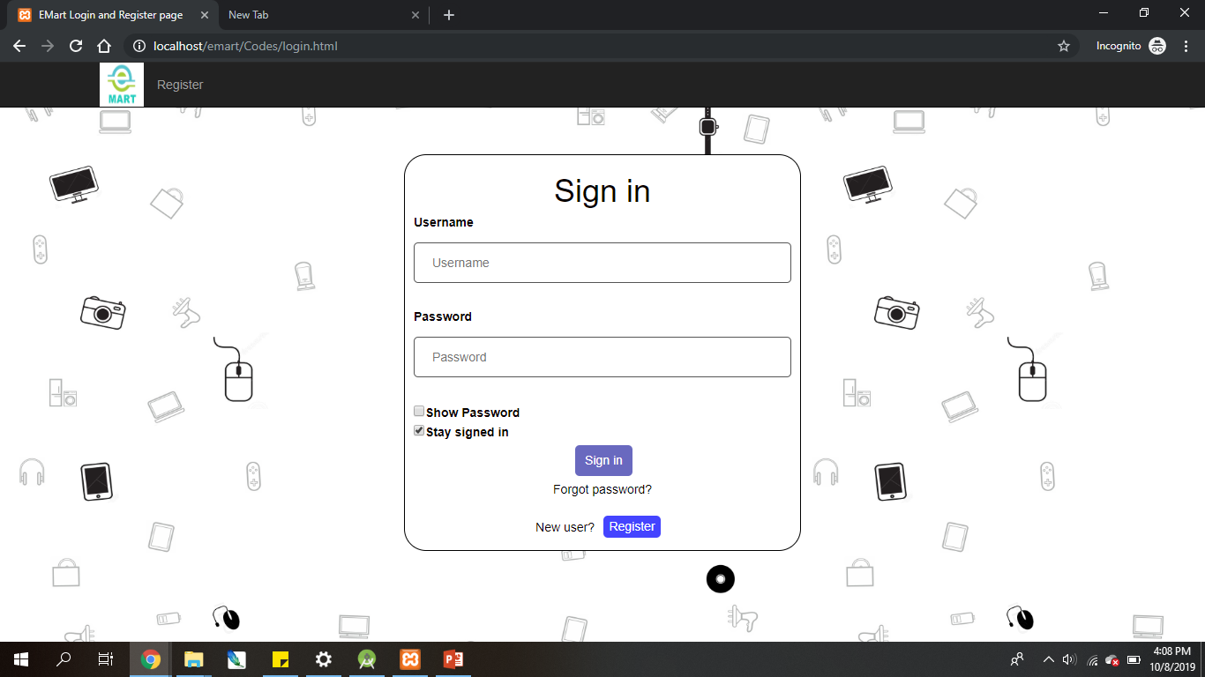
Admin Login Page
Prakash Mamidi

Slide 9
Add Product
Admin can add products by providing
Category of product
Name
Price
Description
Product Image
Lakshmi Vancha

Slide 10
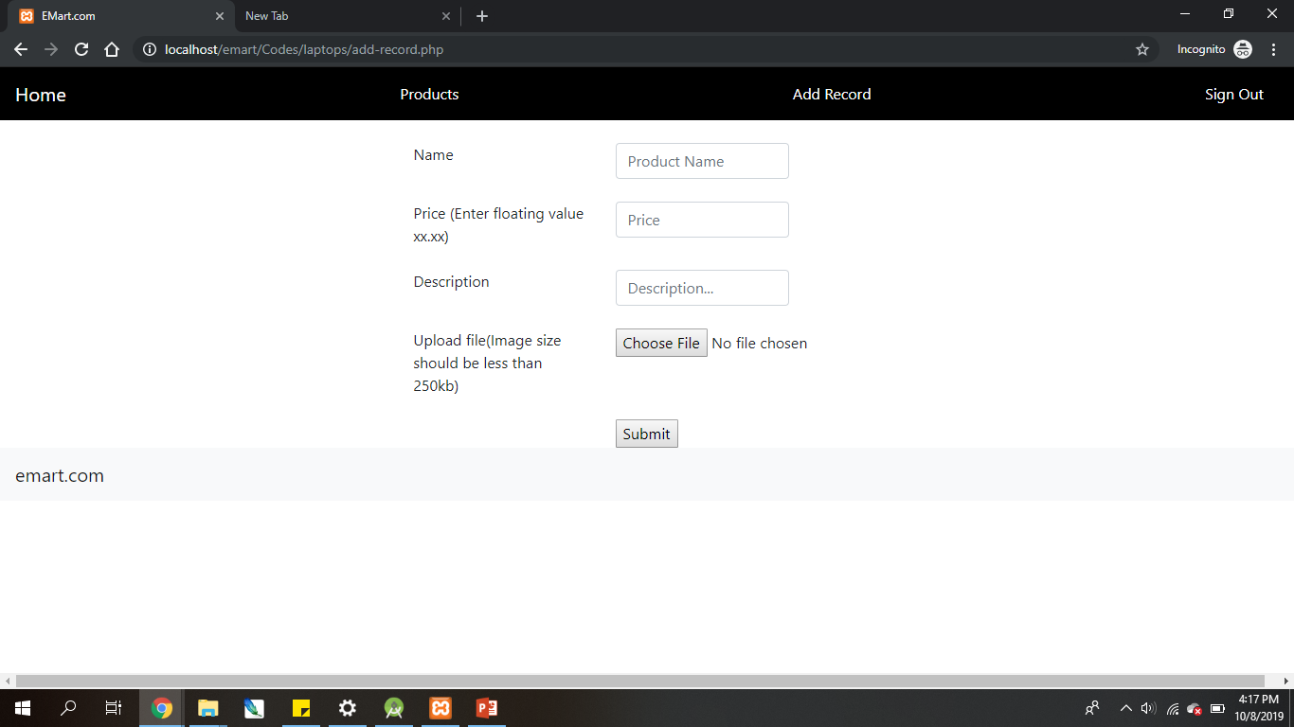
Add Product Page
Lakshmi Vancha

Slide 11
Delete Product Page
This page is operated by the admin.
The admin can delete the products that are already added.
The deletion of the product in this page will lead to the deletion of the product in the backend.
Lakshmi Vancha

Slide 12
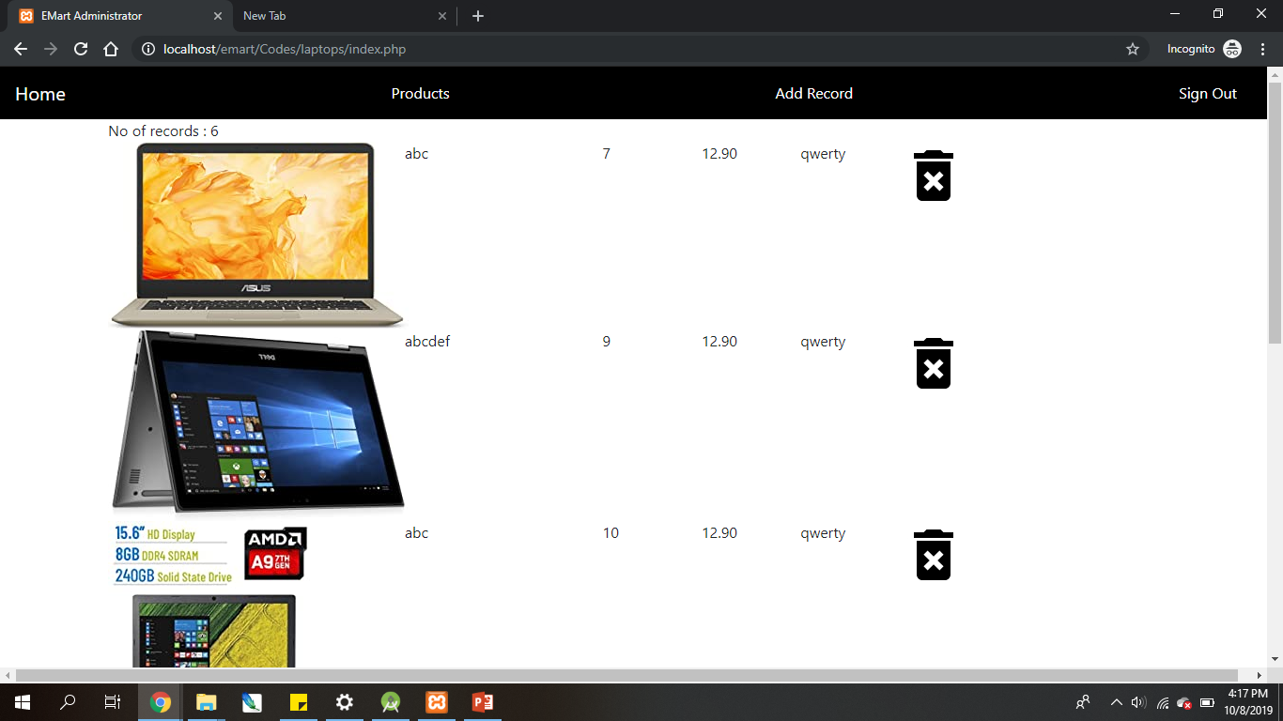
Delete Product Page
Lakshmi Vancha

Slide 13
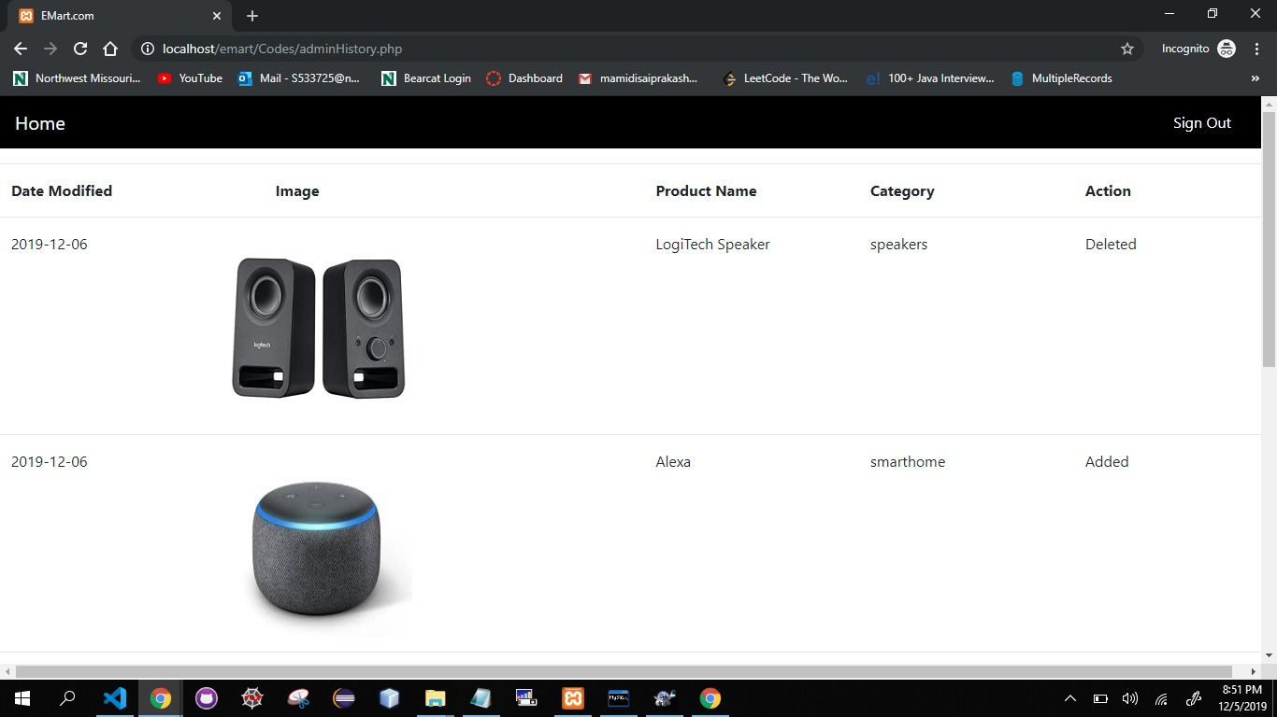
Admin - History
In this page the admin can view the history of the products he had added previously.
Prakash Mamidi

Slide 14
User - Register Page
Ramesh Nutulapathi

Slide 15
User- Login Page
Ramesh Nutulapathi

Slide 16
Home - User
The user can view the list of products in this page.
User can select a specific category from:
Laptops
Speakers
Tablets
Computer & Accessories
Mobile & Accessories
Office Electronics
Photo & Video
Smart Home
TV & Video
Aakash

Slide 17
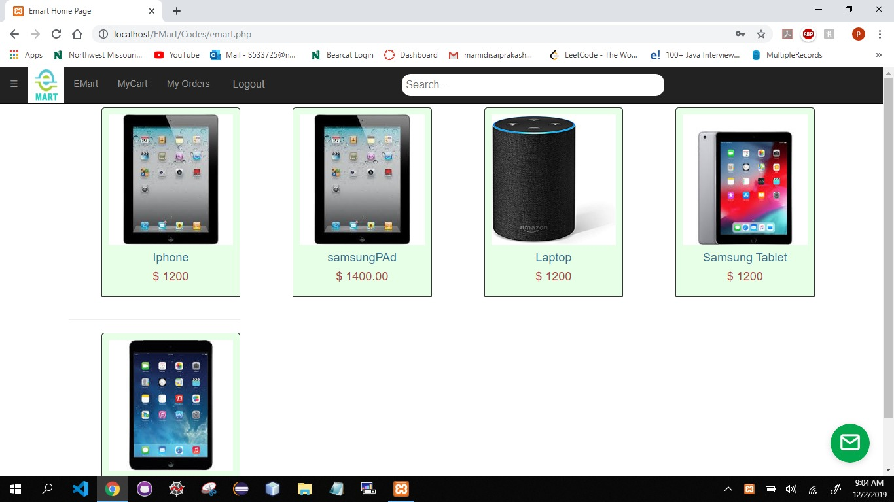
Home - User
Aakash

Slide 18
Chat
The customer/user can get help from the Emart support team by posting their queries in this page.
We use tawk.to to implement this functionality.
Dasari Venkat

Slide 19
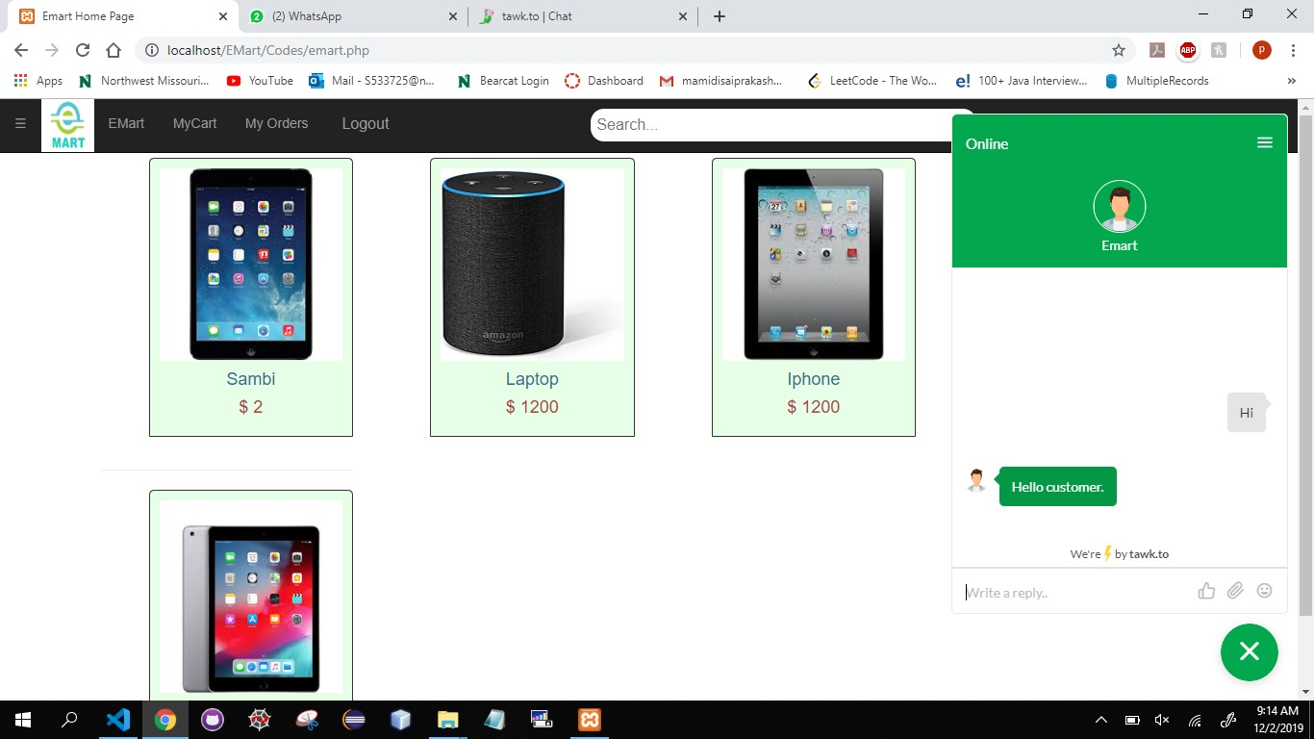
Chat
Dasari

Slide 20
My Cart
Cart Page:
In cart page user can view the product added to cart and the user can also able to see the cost of the product.
Jyoshna Boppidi

Slide 21
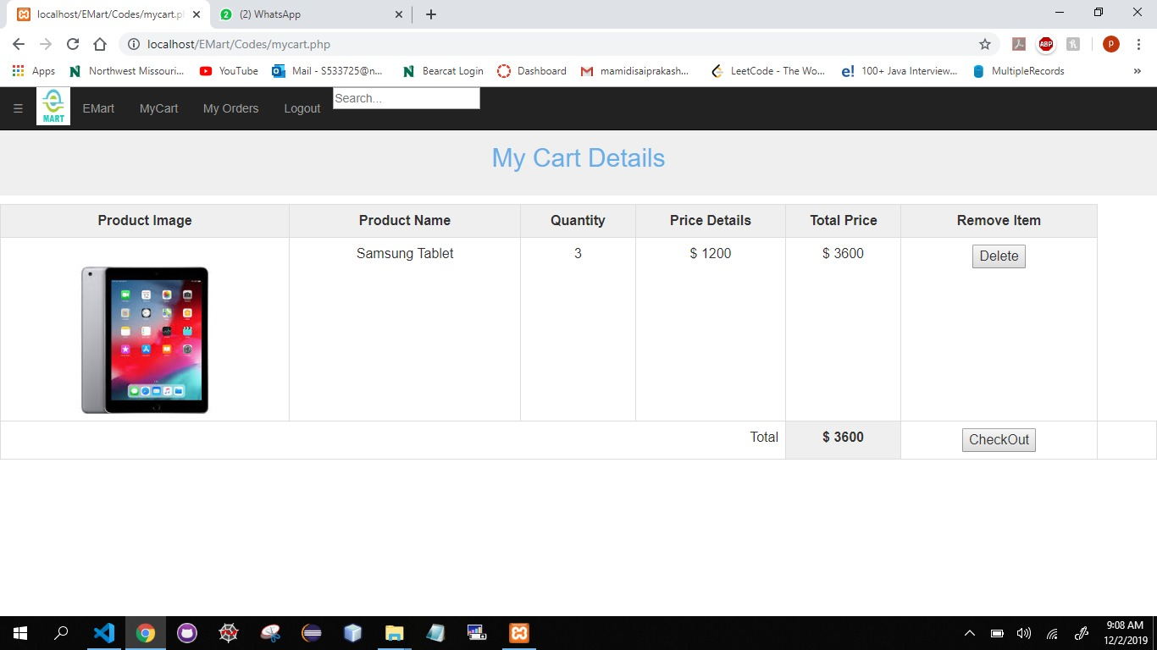
My Cart
Jyoshna Boppidi

Slide 22
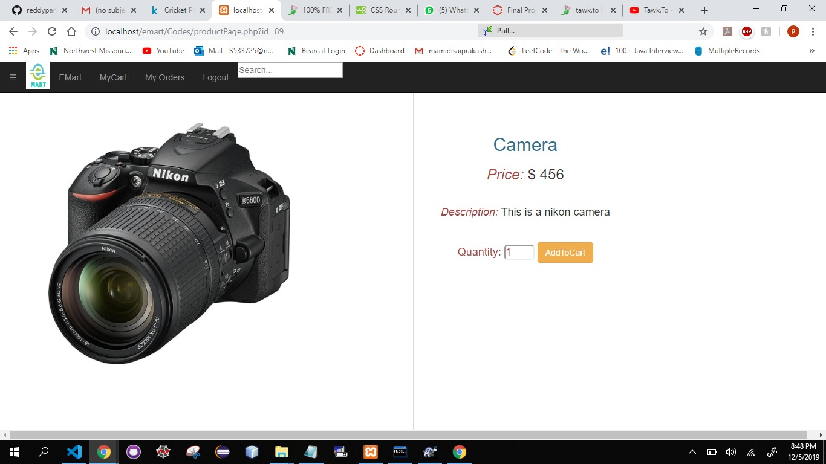
Product Page
Jyoshna Boppidi

Slide 23
Checkout Page
User should fill the details like billing address and card information to place the order.
Havya Ravipati

Slide 24
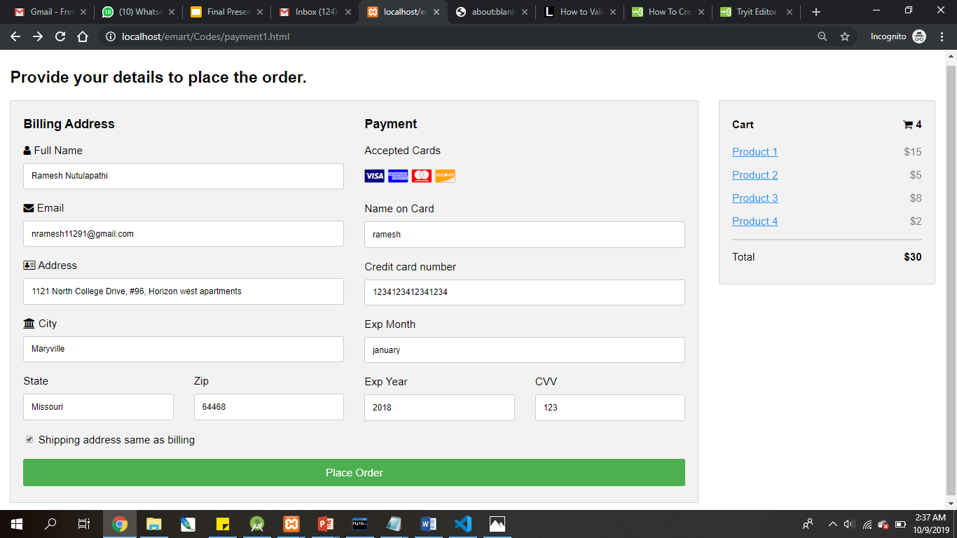
Havya Ravipati

Slide 25
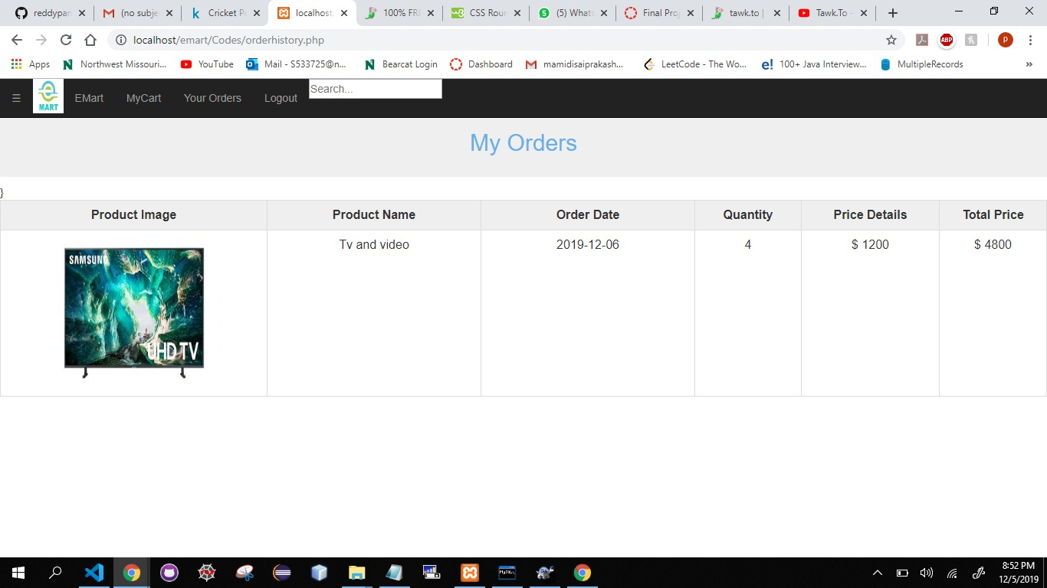
Order History:
In this page user can see the history of previous orders.
Jyoshna Boppidi

Slide 26
Summary
The building of Admin pages have been completed which includes CRUD operations.
The building of user pages has been completed.
The implementation of both front and back end for all the functionalities have been completed.
Havya Ravipati

Slide 27
Team Members:

Slide 28
Thank You!
🙏
😊
Any questions?

